Slide 1
Finite
Boolean Algebra
Lecture 8
Discrete Mathematical Structures

Slide 2
At the Last Class …
Part I: Partial Order
  Order relations and Hasse Diagrams
  Extremal elements in partially ordered sets
Part II: Lattices
  Lattices as a mathematical structure
  Isomorphic lattices
  Properties of lattices

Slide 3
Finite Boolean Algebra
Part I: Finite Boolean Algebra
  Boolean algebra: a special type of lattice
  Substitution rule for Boolean algebra
Part II: Logical Design
  Boolean expressions
  Circuit Design

Slide 4
Lattice (P(S),⊆)
For a finite set S:
  The power set of S, P(S), is a finite set of 2^{|S|} elements.
  Set inclusion is a partial order on P(S).
  (P(S),⊆) is a lattice
    For any subsets of S, S₁ and S₂, S₁∪S₂ is the (unique) least upper bound of S₁ and S₂; and S₁∩S₂ is the (unique) greatest lower bound of S₁ and S₂

Slide 5
Isomorphism of Finite Lattices
All finite lattices having the same number of elements are isomorphic.
If S₁={x₁,x₂,...,x_{n}} and S₂={y₁,y₂,...,y_{n}} are any two finite sets with the same number of elements, then (P(S₁),⊆) and (P(S₂),⊆) are isomorphic.
  Proof:
  A one-to-one correspondence: f(x_{i})=y_{i} for i=1,2,...,n.
  For any subset A,B of S₁, A⊆B iff. f(A)⊆f(B)

Slide 6
Hasse Diagrams of Isomorphic Lattices
{a,b,c}
{2,3,5}
111
{a,b}
{2,3}
110
{a,c}
{b,c}
{2,5}
{3,5}
101
011
{b}
{3}
010
{c}
{5}
{a}
{2}
001
100
φ
φ
000

Slide 7
Lattice B_{n}
B_{n} has 2^{n} elements.
Each element is labeled by a sequence of 0’s and 1’s of length n.
For any elements x=a₁a₂...a_{n}, y= b₁b₂...b_{n}, in B_{n} (each a_{i},b_{i} is 0 or 1):
  x≼y iff. a_{k}≼b_{k} for k=1,2,...,n.
  x∧y = c₁c₂...c_{n}, where c_{k}=min{ a_{k},b_{k} }
  x⋁y = d₁d₂...d_{n}, where d_{k}=max{ a_{k},b_{k} }

Slide 8
Hasse Diagrams of B_{n}
111
1
11
110
10
101
011
01
n=0
010
001
00
100
0
n=1
n=2
000
n=3

Slide 9
Boolean Algebra
A finite lattice isomorphic with B_{n} is called a Boolean Algebra.
An example, D₆
  The set of D₆ is all positive integer divisors of 6
  The partial order with D₆ is divisibility
  D₆ is isomorphic with B₂
  f : D₆→B₂: f(1)=00,f(2)=10,f(3)=01,f(6)=11

Slide 10
B_{n} is distributive and Complemented
For any x in B_{n}, x has a complement x’ = z₁z₂...z_{n}, where z_{k}=1 if x_{k}=0, and z_{k}=0 if x_{k}=1.
For any elements x=a₁a₂...a_{n}, y= b₁b₂...b_{n}, z=c₁c₂...c_{n}, in B_{n} , (each a_{i},b_{i},c_{i} is 0 or 1):
  x∧(y∨z)=(min{a₁,max{b₁,c₁}}) )(min{a₂,max{b₂,c₂}})... (min{a_{n},max{b_{n},c_{n}}}) = (max{min{a₁,b₁}, min{a₁,c₁}}) (max{min{a₂,b₂}, min{a₂,c₂}})...(max{min{a_{n},b_{n}}, min{a_{n},c_{n}}}) = (x∧z)∨(y∧z)
  Similarly, x∨(y∧z)=(x∨z)∧(y∨z)
  So, B_{n} is distributive.

Slide 11
A General Definition of Boolean Algebra
A distributive and complemented lattice is called a Boolean Algebra.
We can define a Boolean algebra directly:
  A set B and a group of operations – join, meet, and complement
  Associative, Commutative and Distributive
  0 and 1
  Complementary element

Slide 12
Some Examples
D_{n} is the poset of all positive divisors of n with the partial order “divisibility”.
30
6
6
10
15
D₂₀ is not a Boolean algebra
2
3
3
5
2
1
1
D₆
D₃₀

Slide 13
D_{n} as Boolean Algebra
Let n=p₁p₂...p_{k}, where the p_{i} are distinct primes. Then D_{n} is a Boolean algebra.
  Sketch of proof:
  Let S={p₁,p₂,...p_{k} }, and for any subset T of S, a_{T} is the product of the primes in T.
  Note: any divisor of n must be some a_{T}. And we have a_{T}|n for any T.
  For any subsets V,T, V⊆T iff. a_{V}|a_{T}, and a_{V}∧a_{T}=GCD(a_{V}, a_{T}) and a_{V}∨a_{T}=LCM(a_{V}, a_{T}).
  f: P(S)→D_{n} given by f(T)= a_{T} is an isomorphism from P(S) to D_{n}.

Slide 14
D_{n} as Boolean Algebra (cont.)
If n is a positive integer and p²|n, where p is a prime number, then D_{n} is not a Boolean algebra.
  Proof:
  Since p²|n, n= p²q for some positive integer q. Note that p is also a element of D_{n}, then if D_{n} is a Boolean algebra, p must have a complement p’, which means GCD(p,p’)=1 and LCM(p,p’)=n. So, pp’=n, which leads to p’=pq. So, GCD(p,pq)=1, contradiction.
So, D_{n} is a Boolean algebra if and only if n=p₁p₂...p_{k}, where the p_{i} are distinct primes.

Slide 15

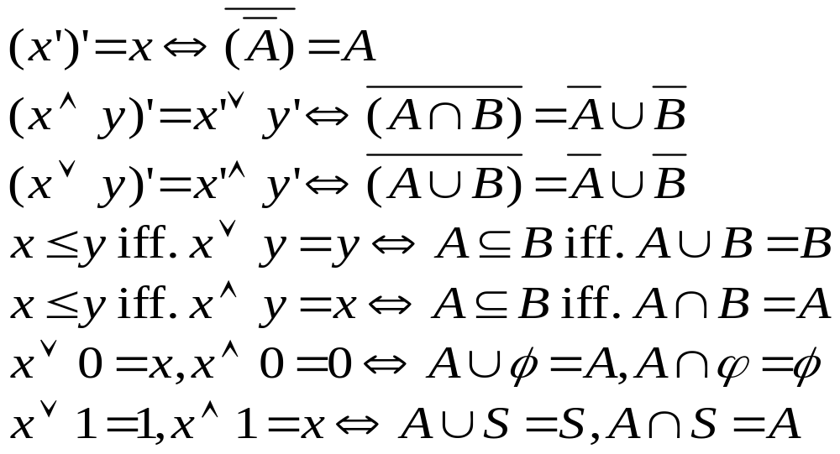
Operation Correspondence
Any formula involving ∪ or ∩ that holds for arbitrary subsets of a set S will continue to hold for arbitrary elements of a Boolean algebra L if ∧ is substituted for ∩ and ∨ for ∪ .
and more!

Slide 16
Proof of Non-Boolean Algebra
For a given poset, if any of the formula satisfied by set operations can’t be satisfied, the poset is not a Boolean algebra.
For ρ(S), every element A has a unique complement ~A, such that:
A∪~A=S and A∩~A=φ
a
c’
e
For L, every element x has a unique complement x’, such that:
x∨x’=1 and x∧x’=0
c

Slide 17
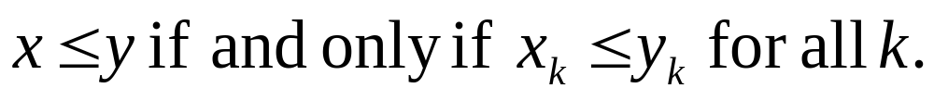
B_{n} as Product of n B’s
B₁, ({0,1},∧,∨,1,0,’), is denoted as B.
For any n≥1, B_{n} is the product B×B×...×B of B, n factors, where B×B×...×B is given the product partial order.
Product partial order:

Slide 18

Truth Table
x₁
x₂
x₃
f(x₁, x₂, x₃)
00001111
00110011
01010101
01101010
x₁
x₂
f(x₁, x₂, x₃)
f: B₃→B
x₃

Slide 19
Boolean Polynomials
x₁,x₂,... x_{n} are all Boolean polynonials (expressions).
The symbols 0 and 1 are Boolean Polynomials.
If p(x₁,x₂,... x_{n}) and q(x₁,x₂,... x_{n}) are two Boolean polynomials, then so are:
p(x₁,x₂,... x_{n}) ⋁ q(x₁,x₂,... x_{n})
p(x₁,x₂,... x_{n}) ⋀ q(x₁,x₂,... x_{n})
(p(x₁,x₂,... x_{n}))’
There are no Boolean polynomials in the variables x_{k} other than those that can be obtained by repeated use of the rules above.

Slide 20
Interpreting Boolean Polynomials
Boolean polynomials may be interpreted as representing Boolean computations with unspecified elements of B, that is, with 0’s and 1’s.
Boolean polynomials are subject to the rules of Boolean algebra.
Two Boolean polynomials are considered equivalent if one can be turned into the other with Boolean manipulations. Or, two boolean polynomials are equivalent if they have the truth tables with the same structure.

Slide 21
Truth Table: an Example
p(x₁,x₂,x₃) = (x1∧ x2)⋁(x1⋁(x2’⋀ x3))
x₁
x₂
x₃
(x₁∧ x₂)⋁(x₁⋁(x₂’⋀ x₃))
00001111
00110011
01010101
01001111

Slide 22
Logic Diagrams for Boolean Polynomials
Basic components:
x
x
x
x’
y
x⋁y
y
x∧y
or gate
and gate
inverter

Slide 23

Logic Diagrams for Boolean Polynomials
x₁
x₂
x₃
(x₁∧ x₂)⋁(x₁⋁(x₂’⋀ x₃))
00001111
00110011
01010101
01001111
f(x,y,z) = (x∧y)∨(y∧z’)
x
y
x∧y
z
z’
y∧z’
f(x,y,z)

Slide 24
Subset of B_{n} Mapping to 1
If f:B_{n}→B, define S(f)={b|b∈B_{n}, and f(b)=1}, then, for three functions from B_{n} to B, f, f₁, f₂, we have:
  If S(f)=S(f₁)∪S(f₂), the f(b)=f₁(b)∨f₂(b) for all b in B.
  If S(f)=S(f₁)∩S(f₂), the f(b)=f₁(b)∧f₂(b) for all b in B.
Proof:
  For any b in B_{n}, if b∈S(f), then f(b)=1. Either b is in S(f₁) or in S(f₂), or both. In either cases f₁(b)∨f₂(b)=1. On ther other hand, if b∉S(f), then f(b)=0. Since neither b∈S(f₁) nor b∈S(f₂), so, f₁(b)∨f₂(b)=0. Thus, for all b∈B_{n}, f(b)=f₁(b)∨f₂(b).
  Same for the second part.
the line in truth table with value 1

Slide 25
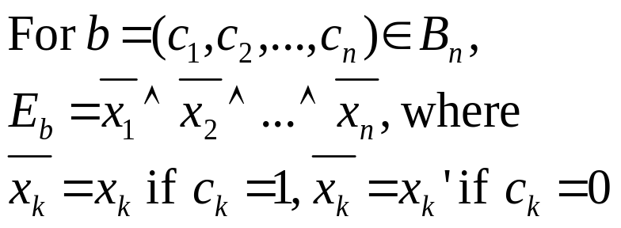
Minterm
x
y
f(x,y)
x₁
x₂
x₃
f(x₁, x₂, x₃)
0011
0101
0100
00001111
00110011
01010101
00100000
x’∧y
x’∧y∧z’
Minterm expression:

Slide 26
All Functions Expressible
Any function f: B_{n}→B can be produced by a Boolean expression
  Union of minterms.
  Proof:
    For any given boolean function f : B_{n}→B, let S(f) = {b₁,b₂,...,b_{k}}
    For each i=1,2,...,k, define function f_{i}: B_{n}→B, as, f(b_{i})=1 and f(b)=0 for any other b.
    Then S(f_{i})={b_{i}}, so, S(f)=S(f₁)∪...∪S(f_{n}).
    So, f = f₁∨f₂∨...,∨f_{n}, which is produced by the union of all minterms E_{bi}

Slide 27
Karnaugh Map of f for n=2
f: B₂→B
f(x,y)=(x’∧y’)∨(x’∧y)
x
y
f(x,y)
Basic positions
0 0 1 1
0 1 0 1
1 1 0 0
00
01
10
11
However,we know
f(x,y)=x'!
y’
y
y’
y
x’
1
1
x’
x’∧y’
x’∧y
x
x∧y’
x∧y
x
0
0

Slide 28
Simplifying Using Karnaugh Map
f: B₂→B
f(x,y)=(x’∧y’)∨(x’∧y)∨(x∧y’)
x
y
f(x,y)
Basic positions
0 0 1 1
0 1 0 1
1 1 1 0
00
01
10
11
f(x,y) = x’ ∨ y ’
y’
y
y’
y
x’
1
1
x’
x’∧y’
x’∧y
x
x∧y’
x∧y
x
1
0

Slide 29
Karnaugh Map with n=3
00
01
11
10
0
0 0 0
0 0 1
0 1 1
0 1 0
1
1 0 0
1 0 1
1 1 1
1 1 0
y’
y
y’∧z’
y’∧z
y∧z
y∧z’
x’
x’∧y’∧z’
x’∧y’∧z
x’∧y∧z
x’∧y∧z’
x
x’∧y’∧z’
x∧y’∧z
x∧y∧z
x∧y∧z’
z
z’

Slide 30
Simplifying 3-Variable Expression
x
y
z
f(x,y,z)
y’z’
y’z
yz
yz’
00001111
00110011
01010101
10101011
x’
1
0
0
1
x
1
0
1
1
z’
the expression:
(x’∧y’∧z’)∨ (x’∧y∧z’)∨ (x∧y’∧z’)∨ (x∧y∧z’)∨ (x∧y∧z)
So, z’∨(x∧y)

Slide 31
Logic Circuit at Work
For each try in a contest of weight lifting, it is assumed success only if at least 2 of 3 referees decide it a success. Design a logic circuit for use in the situation.
The function: f(x,y,z)=1 iff. there are at least 2 one’s in x,y,z
x
y
z
f(x,y,z)
00001111
00110011
01010101
00010111
the expression:
(x’∧y∧z)∨ (x∧y’∧z)∨ (x∧y∧z’)∨ (x∧y∧z)

Slide 32
The Circuit
Too complecated!
the expression:
(x’∧y∧z)∨ (x∧y’∧z)∨ (x∧y∧z’)∨ (x∧y∧z)
x
x’
y
f(x,y,z)
y’
z
z’

Slide 33
Make it Simpler
y’z’
y’z
yz
yz’
x
y
z
f(x,y,z)
00001111
00110011
01010101
00010111
x’
0
0
1
0
x
0
1
1
1
z’
the expression:
(y∧z)∨ (x∧z)∨ (x∧y)

Slide 34
Looks Better
the expression:
(y∧z)∨ (x∧z)∨ (x∧y)
x
y
f(x,y,z)
z

Slide 35
K-map of 4-Variable Expressions
For 4-variable Boolean expression f (x,y,z,w)
w’
00 01 11 10
z
0000 | 0001 | 0011 | 0010
0100 | 0101 | 0111 | 0110
1100 | 1101 | 1111 | 1110
1000 | 1001 | 1011 | 1010
00
01
11
10
y
x
y’
w

Slide 36
An Example
1 | 0 | 0 | 1
0 | 1 | 1 | 0
0 | 1 | 1 | 0
1 | 0 | 0 | 1
(w∧y)
y
(w’∧y’)
So, (w∧y)∨(w’∧y’)
w

Slide 37
Another Example
z
2×2 square gives 2-literal minterm
(z ’∧y ‘)
1 | 1 | 1 | 1
0 | 0 | 0 | 0
0 | 0 | 1 | 0
1 | 1 | 0 | 0
1×1 square gives 4-literal minterm
(x ∧y ∧z∧w)
x’
y’
y’
So: the Boolean sum of the three
(z’∧y’)∨(x’∧y’∧z)∨(x ∧y ∧z∧w)
z’
1×2 square gives 3-literal minterm
(x ’∧y ‘∧z)
In fact, another view gives x’y’∨y’z’

Slide 38
Same, or Different
The same Boolean function may take different forms, and,…
The same circuit can implement different Boolean functions, maybe with some exchanges on inputs.

Slide 39
Home Assignments
To be checked
  pp.231: 2, 4, 6, 8, 10, 16, 18, 20, 27, 29, 32
  pp.236: 11-14, 17, 20, 23
  pp.246: 12, 14, 16, 25-26
Self tests
Experiment 6

